Slide 1
Time Series
Time Series vs Non Time Series
Regression problem
supervised
ML data
Sales Data
Upper margin
Lower margin
errors
Month/year

Slide 2
Time Series
T-1 T T+1
Depending on
Previous lag
How many Lags should be done

Slide 3
Future Forecasting
Sales D
T T+1
For Specific Time we nedd
Eg for t=3
This is called as Extrapolation
Focus on forecasting
In timeseries we are depending on t , t-1 , t-3 previous time lags
Main aim is to forcasting the data at current time
As we go head errors occurs.
Future Forecasting

Slide 4
Basic Idea Of Time Series Data
Upward Trend
Stationary Trend
Downward Trend
Cyclic Trend

Slide 5
Upward Trend
AC Sales Data
Monthly

Slide 6
Downward Trend
AC Sales Data
Monthly

Slide 7
Stationary Trend
AC Sales Data
Monthly

Slide 8
Cyclic Trend
People sentiment
News
Stock Market Data
Sales Data → Forecast
Mean Average
(Rolling Window)
Monthly

Slide 9
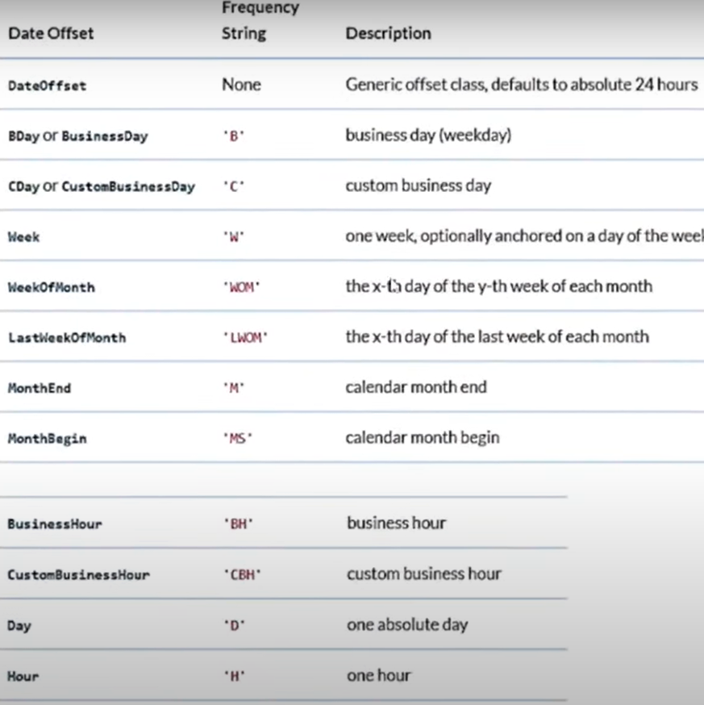
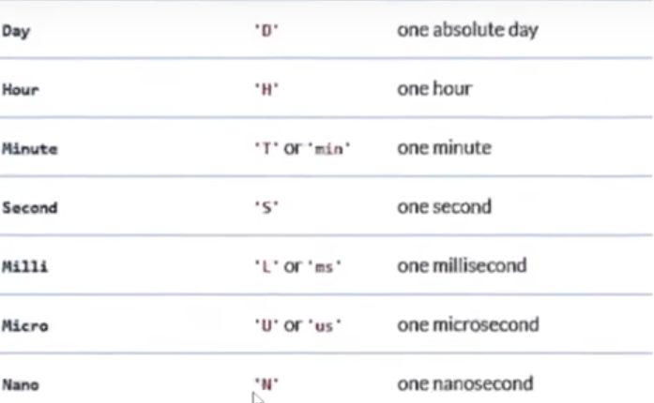
Data offsets with description

Slide 10
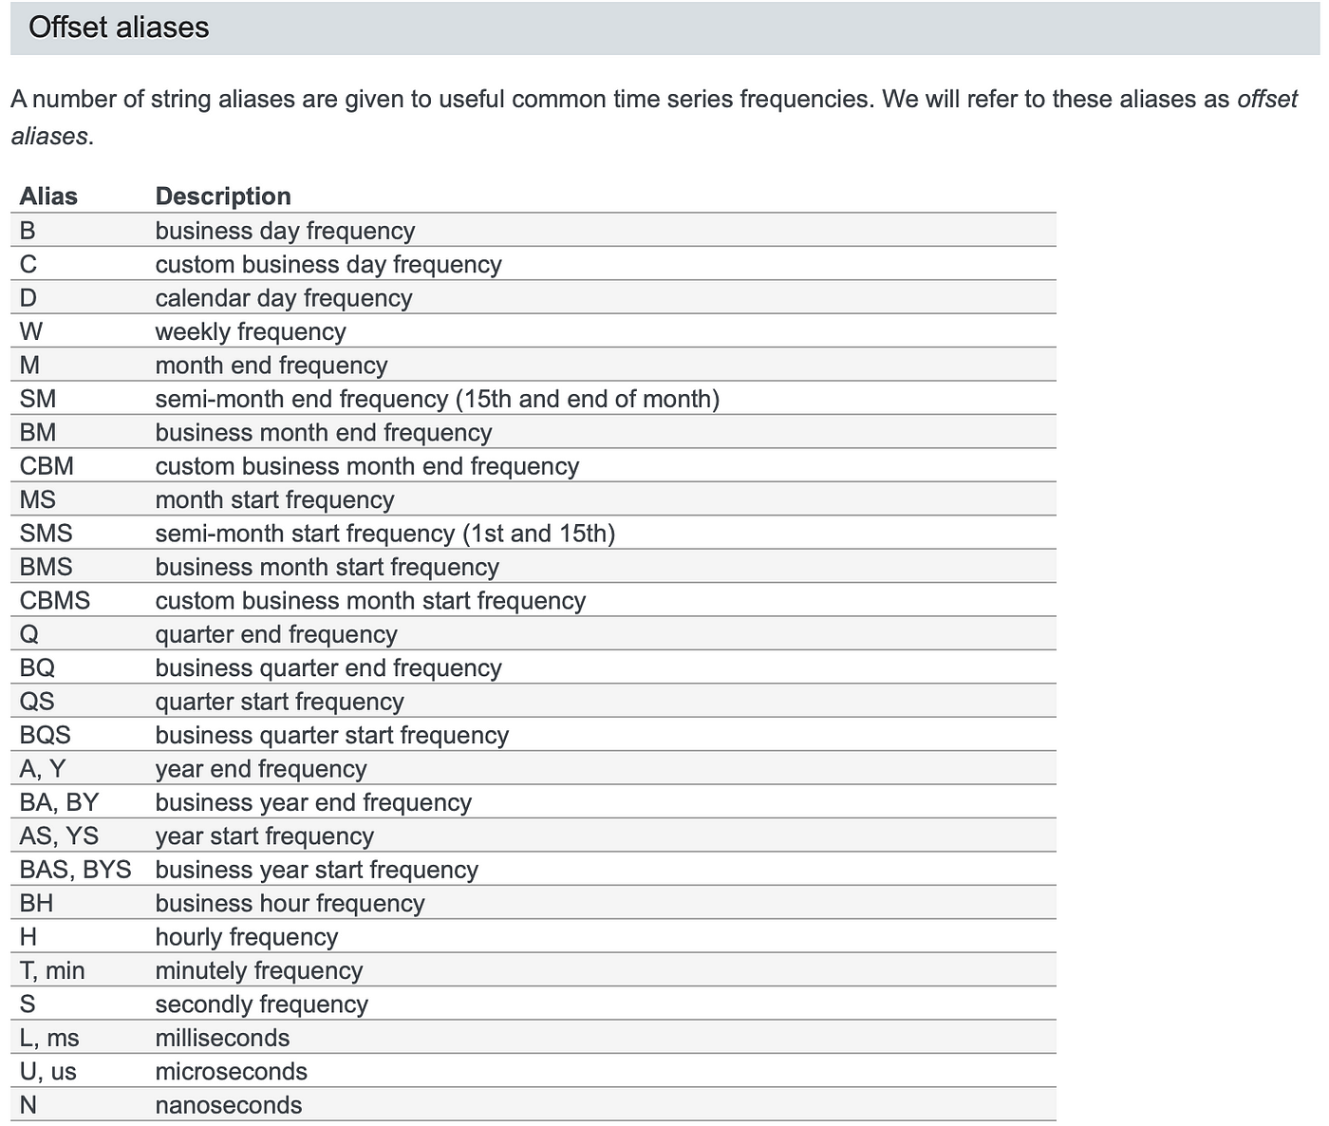

Slide 11
CMA(Cumulative moving average) 1 2 3 4 5 6 7
1.5
2
2.5
3
3.5
4

Slide 12
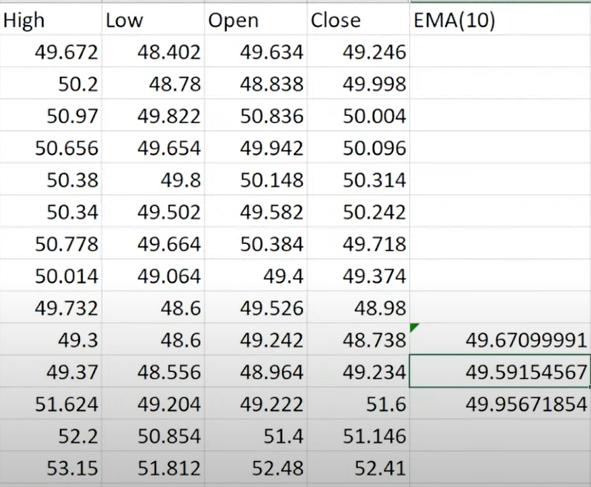
EMA:- Expo Moving Average
Multiplier-> Formula= (2/10)+1
10=Rolling value

Slide 13
EWMA:- Expo Weighted Moving Average
weight
W for prevent lag
EWMA(t)= a * x(t) + (1-a) EWMA(t-1)
With
First priority this
Data.
With respect to t
Still After coming new data we are going to give first priority previous data

Slide 14
ARIMA
ARIMA→ AR I MA
Autoregression --------→ + <--------- Moving average
ARIMA MODEL
Forecasting: Sales,monthly
Not Good for Stocks

Slide 15
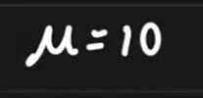

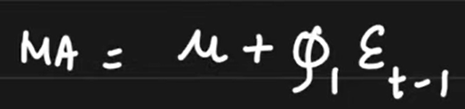
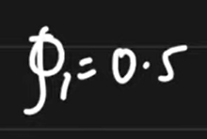
Moving Average ACF (Auto Corr Plot) -- (MA)
Moving Average Models
Currently what I am doing: Live session of time series day3
Batch size = 10 [Expected to join all students]
But Present only
T
Days
MA
pred
MA
Real
Error
1
2
3
4
5
10
-2
1
-1
2
0
8
Standard Normal distribution
Coefficient

Slide 16
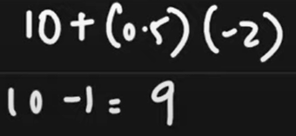
T
Days
MA
pred
MA
Real
Error
1
2
3
4
5
10
9
9.5
9
11
-2
1
-1
2
0
8
10
8.5
11
10

Slide 17
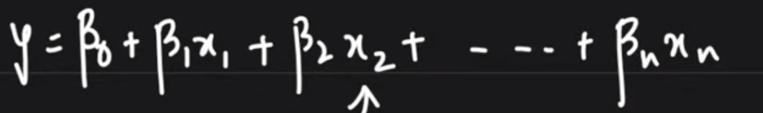
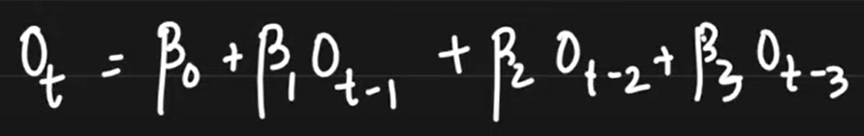
Auto Regression =
Sales of Onion
t-4 | t-3 | t-2 | t-1 | t
Jan | Feb | March | April
t-3 | t-2 | t-1 | t
May
K=4
Sales Pred
Regression Algorithm
Jan | Feb | Mar
t-2 | t-1 | t
K=4,2,3
PACF graph
Y=mx+c

Slide 18
PACF corr
Upper Bound
p= how many lines crossing upper or lower boundaries=4=ARIMA
d
q
+
-
Lower Bound
1 2 3 4 5 6 7 Lags
If PACF will cross Upper or Lower bound then it is affecting on current time predictions

Slide 19
AC Sales Data
12 months
Monthly

Slide 20
SARIMAX
We provide
sessional ( p,d,q, #season 12) values
We provide
p, d, q values

Slide 21
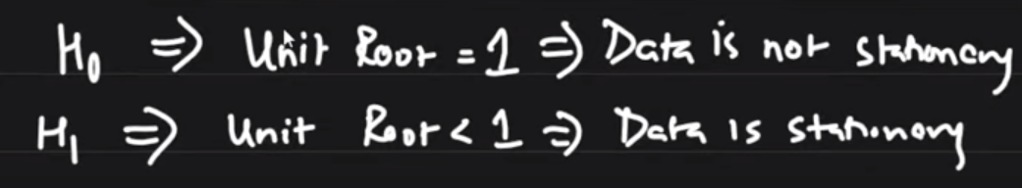
ARIMA or SARIMA model check points
Check the data for stationary
We follow some steps for stationary
Hypothesis Dickey Fuller Test
Mean should be constant
Standard deviation should be constant

Slide 22
Dickey Fuller Test
Gives 2 internally values
If p value is < 0.5 → Null hypo rejected
If p value >= 0.5 → Null hype excepted

Slide 23
Shifting & Difference
Date | Sales | Sales(t-1) | Diffrencing
 | 100 | Nan | Nan
 | 120 | 100 | 20
 | 130 | 120 | 10
 | 140 | 130 | 10
 | 150 | 140 | 10
 |  | 150 deleted | 140
 |  |  | 150
We provide all data to dickey fuller test.
p < 0.5
p >= 0.5
AR I MA
p d q
Pacf diffren ACF

Slide 24
0.5
AR I MA
p d q
Pacf diffren ACF
AR
+
+
Output
I = integrated value
MA formula

Slide 25
Corr
X | Y | Z
Jan | Feb | Mar
Feb | Mar | April
Mar | April | May
April | May | June

Slide 26
Sessional Data : SARIMAX
With The Help Of PACF →
We are Performing AR → P Value
With The Help Of ACF →
We are Performing MA → q Value
Difference → d value

Slide 27
Moving Average ACF (Auto Corr Plot) -- (MA) Formula → q value
Difference → I value → How much times we have to differentiated
Auto Regressive Model PACF(Partial Auto Corr Plot)-- (AR) → Boundary lines cross → P value
sessional ( p,d,q, #season 12)
converting to month in datetime → object to datetime
Setting index = month → df_airline.set_index('Month',inplace=True)
Checking data is stationary → seassional is not stationary data
dicifular test → value is < 0.05 or value >= 0.05
If value < 0.05 →stationary
If value > 0.05 → Non- stationary
from statsmodels.tsa.stattools import adfuller
After checking n times we will get value < 0.05 and that n is difference → I value (2)
While getting difference
ACF and PACF graph plot
from statsmodels.graphics.tsaplots import plot_acf,plot_pacf
split train and test data
train_data=df_airline[:train_dataset_end]
test_data=df_airline[train_dataset_end+timedelta(days=1):test_dataset_end]
prediction
pred_start_date=test_data.index[0]
pred_end_date=test_data.index[-1]
create a ARIMA model → import statsmodels.api as sm → We provide (p,i,q) values
Processes of Creating ARIMA And SARIMA

Slide 28
ARIMA model
dicifular test → value is < 0.05 or value >= 0.05
If value < 0.05 →stationary
If value > 0.05 → Non- stationary
from statsmodels.tsa.stattools import adfuller
After checking n times we will get value < 0.05 and that n is difference → I value (2)
While getting difference
Moving Average ACF (Auto Corr Plot) -- (MA) Formula → q value
Difference → I value → How much times we have to differentiated
Auto Regressive Model PACF(Partial Auto Corr Plot)-- (AR) → Boundary lines cross → P value
sessional ( p,d,q, #season 12)
converting to month in datetime → object to datetime
Setting index = month → df_airline.set_index('Month',inplace=True)
Checking data is stationary → seassional is not stationary data
ACF and PACF graph plot
from statsmodels.graphics.tsaplots import plot_acf,plot_pacf

Slide 29
split train and test data
train_data=df_airline[:train_dataset_end]
test_data=df_airline[train_dataset_end+timedelta(days=1):test_dataset_en d]
prediction
pred_start_date=test_data.index[0]
pred_end_date=test_data.index[-1]
create a ARIMA model → import statsmodels.api as sm → We provide (p,i,q) values

Slide 30
create a SARIMA model
from statsmodels.tsa.statespace.sarimax import SARIMAX
model_SARIMA=SARIMAX(train_data['Thousands of Passengers'],order=(1,2,1),seasonal_order=(1,2,1,12))
Values we are going to provide in SARIMA → seasonal_order=(1,2,1,12))→ p,I,q,season lags

